Slide 1

Bits, Bytes, and Integers
CSCI3240: Lecture 2 and 3
Dr. Arpan Man Sainju
Middle Tennessee State University

Slide 2
Today: Bits, Bytes, and Integers
Representing information as bits
Bit-level manipulations
Integers
Representation: unsigned and signed
Conversion, casting
Expanding, truncating
Addition, negation, multiplication, shifting
Summary
Representations in memory, pointers, strings

Slide 3
Everything is bits
Each bit is 0 or 1
By encoding/interpreting sets of bits in various ways
Computers determine what to do (instructions)
… and represent and manipulate numbers, sets, strings, etc…
Why bits? Electronic Implementation
Easy to store with bistable elements
Reliably transmitted on noisy and inaccurate wires
0
1
0
1.1V
0.9V
0.2V
0.0V

Slide 4
For example, can count in binary
Base 2 Number Representation
Represent 15213₁₀ as 11101101101101₂
Represent 1.20₁₀ as 1.0011001100110011[0011]…₂
Represent 1.5213 X 10⁴ as 1.1101101101101₂ X 2¹³

Slide 5
Encoding Byte Values
Decimal
Hex
Binary
Byte = 8 bits
Binary 000000002 to 111111112
Decimal: 010 to 25510
Hexadecimal 0016 to FF16
Base 16 number representation
Use characters ‘0’ to ‘9’ and ‘A’ to ‘F’
Write FA1D37B16 in C as
0xFA1D37B
0xfa1d37b
0
0
0000
1
1
0001
2
2
0010
3
3
0011
4
4
0100
5
5
0101
6
6
0110
7
7
0111
8
8
1000
9
9
1001
A
10
1010
B
11
1011
C
12
1100
D
13
1101
E
14
1110
F
15
1111

Slide 6
Example Data Representations
C Data Type | Typical 32-bit | Typical 64-bit | x86-64
char | 1 | 1 | 1
short | 2 | 2 | 2
int | 4 | 4 | 4
long | 4 | 8 | 8
float | 4 | 4 | 4
double | 8 | 8 | 8
long double | − | − | 10/16
pointer | 4 | 8 | 8
Number of bytes for each data type in C

Slide 7
Today: Bits, Bytes, and Integers
Representing information as bits
Bit-level manipulations
Integers
Representation: unsigned and signed
Conversion, casting
Expanding, truncating
Addition, negation, multiplication, shifting
Summary
Representations in memory, pointers, strings

Slide 8
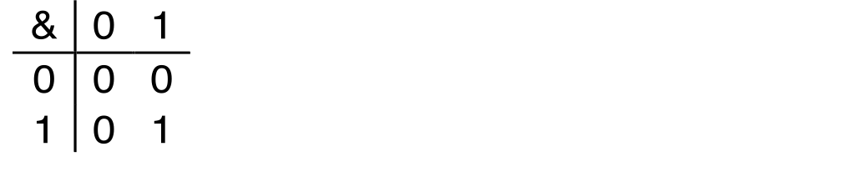
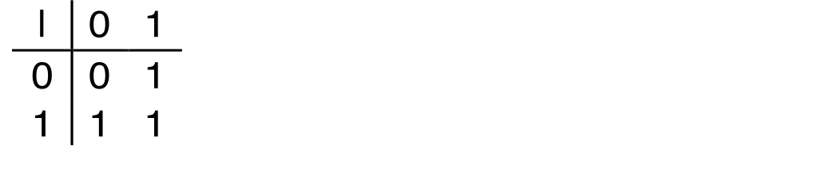
Boolean Algebra
Developed by George Boole in 19th Century
Algebraic representation of logic
Encode “True” as 1 and “False” as 0
And Operation
A&B = 1 when both A=1 and B=1
Or Operation
A|B = 1 when either A=1 or B=1
B
B
A
A

Slide 9
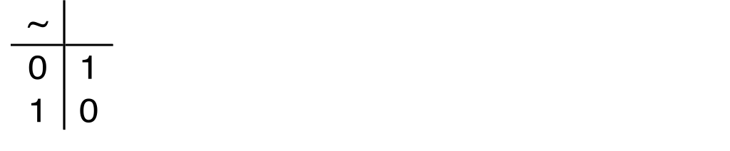
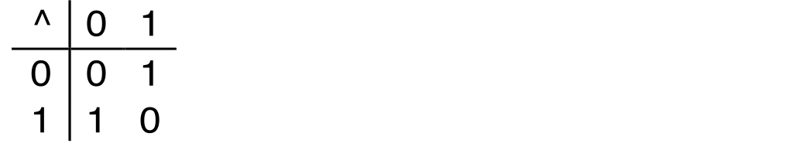
Boolean Algebra
Not and Xor Operations
Not Operation
~A = 1 when A=0
Exclusive-Or (Xor) Operation
A^B = 1 when either A=1 or B=1, but not both
B
A
A

Slide 10
General Boolean Algebras
Operate on Bit Vectors
Operations applied bitwise
All of the Properties of Boolean Algebra Apply
01101001
& 01010101
01000001
01101001
| 01010101
01111101
01101001
^ 01010101
00111100
~ 01010101
10101010
01000001
01111101
00111100
10101010
AND
OR
NOT
XOR

Slide 11
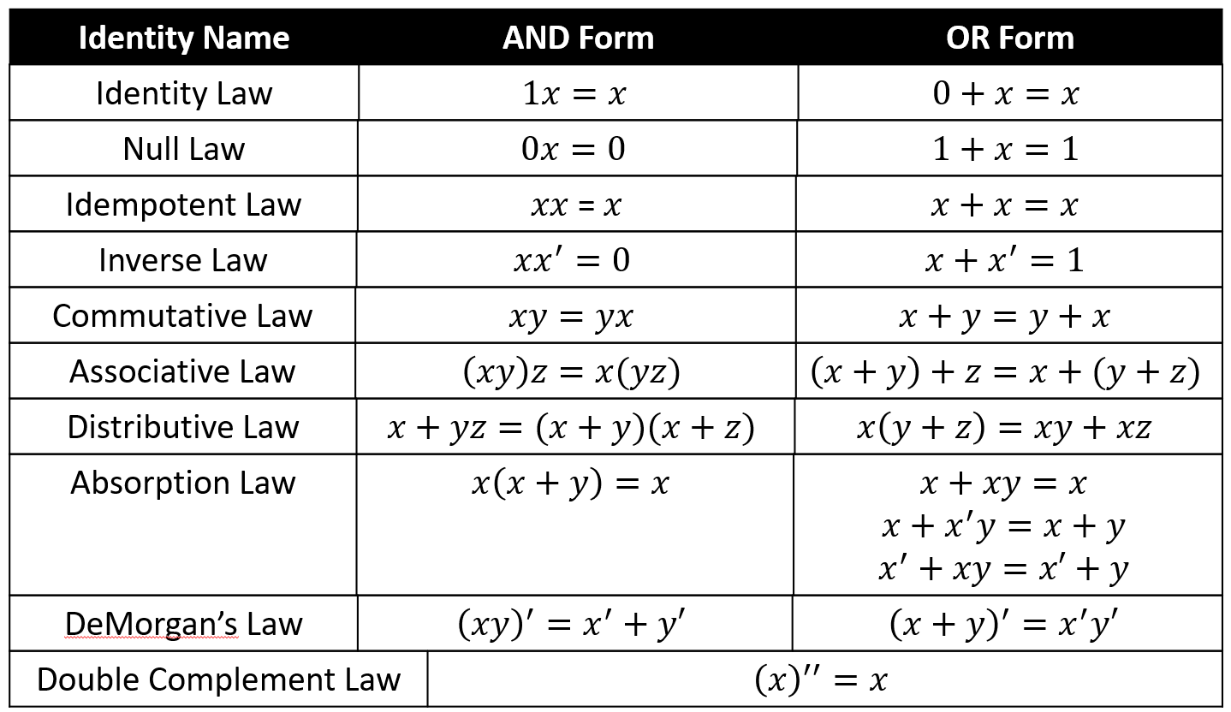
Boolean Properties

Slide 12
Example: Representing & Manipulating Sets
Representation
Width w bit vector represents subsets of {0, …, w–1}
a_{j} = 1 if j ∈ A
N = 01101001 { 0, 3, 5, 6 }
76543210
M= 01010101 { 0, 2, 4, 6 }
76543210
Operations
& Intersection N&M= 01000001 { 0, 6 }
| Union N|M= 01111101 { 0, 2, 3, 4, 5, 6 }
^ Symmetric difference N^M= 00111100 { 2, 3, 4, 5 }
~ Complement ~M= 10101010 { 1, 3, 5, 7 }

Slide 13
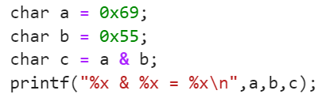
Bit-Level Operations in C
Operations &, |, ~, ^ Available in C
Apply to any “integral” data type
long, int, short, char, unsigned
View arguments as bit vectors
Arguments applied bit-wise
Examples (Char data type)
~0x41 ⇒ 0xBE
~010000012 ⇒ 101111102
~0x00 ⇒ 0xFF
~000000002 ⇒ 111111112
0x69 & 0x55 ⇒ 0x41
011010012 & 010101012 ⇒ 010000012
0x69 | 0x55 ⇒ 0x7D
011010012 | 010101012 ⇒ 011111012
Console Output
69 & 55 = 41

Slide 14
Contrast: Logic Operations in C
Contrast to Logical Operators
&&, ||, !
View 0 as “False”
Anything nonzero as “True”
Always return 0 or 1
Early termination
Examples (char data type)
!0x41 ⇒ 0x00
!0x00 ⇒ 0x01
!!0x41 ⇒ 0x01
0x69 && 0x55 ⇒ 0x01
0x69 || 0x55 ⇒ 0x01
p && *p (avoids null pointer access)

Slide 15
Contrast: Logic Operations in C
Contrast to Logical Operators
&&, ||, !
View 0 as “False”
Anything nonzero as “True”
Always return 0 or 1
Early termination
Examples (char data type)
!0x41 ➙ 0x00
!0x00 ➙ 0x01
!!0x41 ➙ 0x01
0x69 && 0x55 ➙ 0x01
0x69 || 0x55 ➙ 0x01
p && *p (avoids null pointer access)
Watch out for && vs. & (and || vs. |)…
one of the more common oopsies in
C programming

Slide 16
Shift Operations
Argument x
01100010
Left Shift: x << y
Shift bit-vector x left y positions
Throw away extra bits on left
Fill with 0’s on right
Right Shift: x >> y
Shift bit-vector x right y positions
Throw away extra bits on right
Logical shift
Fill with 0’s on left
Arithmetic shift
Replicate most significant bit on left
Undefined Behavior
Shift amount < 0 or ≥ word size
<< 3
00010000
00010000
00010000
Log. << 2
00011000
00011000
00011000
Arith. << 2
00011000
00011000
00011000
Argument x
10100010
>> 3
11110100
00010000
00010000
Log. >> 2
00101000
00101000
00101000
Arith. >> 2
11101000
11101000
11101000

Slide 17
Today: Bits, Bytes, and Integers
Representing information as bits
Bit-level manipulations
Integers
Representation: unsigned and signed
Conversion, casting
Expanding, truncating
Addition, negation, multiplication, shifting
Summary
Representations in memory, pointers, strings
Summary

Slide 18
Encoding Integers
Unsigned
Two’s Complement
short int x = 15213;
short int y = -15213;
Sign
Bit
C short 2 bytes long
Sign Bit
For 2’s complement, most significant bit indicates sign
0 for nonnegative
1 for negative

Slide 19
Two-complement Encoding Example (Cont.)
x = 15213: 00111011 01101101
y = -15213: 11000100 10010011

Slide 20
Numeric Ranges
Unsigned Values
UMin = 0
000…0
UMax = 2^{w} – 1
111…1
Two’s Complement Values
TMin = –2^{w–1}
100…0
TMax = 2^{w–1} – 1
011…1
Other Values
Minus 1
111…1
Values for W = 16

Slide 21
Values for Different Word Sizes
Observations
|TMin | = TMax + 1
Asymmetric range
UMax = 2 * TMax + 1
C Programming
#include <limits.h>
Declares constants, e.g.,
ULONG_MAX
LONG_MAX
LONG_MIN
Values platform specific

Slide 22
Printf function: format specifier
Format Specifier | Description
d or i | Signed decimal integer
u | Unsigned decimal integer
o | Unsigned octal number
x | Unsinged hexadecimal number
X | Unsinged hexadecimal in uppercase
f | Decimal floating point
c | Character
s | String
a | Hexadecimal floating-point in lowercase
A | Hexadecimal floating point in uppercase
p | Pointer address
Refer: https://www.delftstack.com/howto/c/format-specifier-lu-in-c/

Slide 23
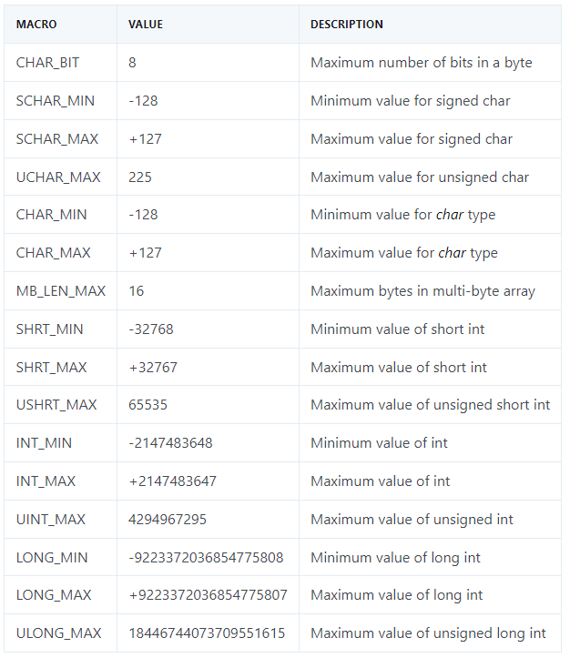
Working with limits in C

Slide 24
Working with limits in C
#include <stdio.h>
#include <limits.h>
int main(){
printf("CHAR_BIT = %i \n",CHAR_BIT);
printf("SCHAR_MIN = %i \n",SCHAR_MIN); // signed character type min
printf("SCHAR_MAX = %i \n",SCHAR_MAX); // singned character type max
printf("UCHAR_MAX = %i \n",UCHAR_MAX); // unsinged char max
printf("CHAR_MIN = %i \n",CHAR_MIN);
printf("CHAR_MAX = %i \n",CHAR_MAX);
printf("SHRT_MIN = %i \n",SHRT_MIN); //min for short data type
printf("SHRT_MAX = %i \n",SHRT_MAX); //max for short data type
printf("USHRT_MAX = %i \n",USHRT_MAX); //,ax for unsigned short data type
printf("INT_MIN = %i \n",INT_MIN); // integer min (default is singed)
printf("INT_MAX = %i \n",CHAR_BIT); // integer max
printf("UINT_MAX = %u \n",UINT_MAX); //unsinged int max
printf("LONG_MIN = %li \n",LONG_MIN); //Minimum value of long int
printf("LONG_MAX = %li \n",LONG_MAX); //Maximum value of long int
printf("ULONG_MAX = %lu \n",ULONG_MAX);
return 0;
}

Slide 25
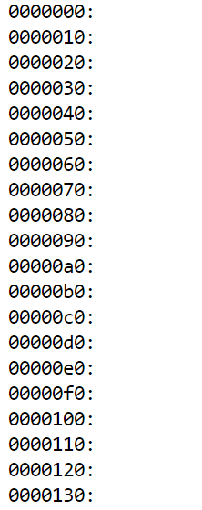
Hint for Project 1
Console Output
#include <stdio.h>
int main(){
int counter= 0;
for (int counter=0;counter<1024; counter+=16)
{
// shows 7 digits output with leading 0s
printf("%07x:\n", counter);
}
return 0;
}

Slide 26
Unsigned & Signed Numeric Values
X
B2U(X)
B2T(X)
0000
0
0
Equivalence
Same encodings for nonnegative values
Uniqueness
Every bit pattern represents unique integer value
Each representable integer has unique bit encoding
⇒ Can Invert Mappings
U2B(x) = B2U⁻¹(x)
Bit pattern for unsigned integer
T2B(x) = B2T⁻¹(x)
Bit pattern for two’s comp integer
0001
1
1
0010
2
2
0011
3
3
0100
4
4
0101
5
5
0110
6
6
0111
7
7
1000
8
–8
1001
9
–7
1010
10
–6
1011
11
–5
1100
12
–4
1101
13
–3
1110
14
–2
1111
15
–1

Slide 27
Today: Bits, Bytes, and Integers
Representing information as bits
Bit-level manipulations
Integers
Representation: unsigned and signed
Conversion, casting
Expanding, truncating
Addition, negation, multiplication, shifting
Summary
Representations in memory, pointers, strings

Slide 28
Mapping Signed ↔ Unsigned
Bits
0000
0001
0010
0011
0100
0101
0110
0111
1000
1001
1010
1011
1100
1101
1110
1111
Signed
0
1
2
3
4
5
6
7
-8
-7
-6
-5
-4
-3
-2
-1
Unsigned
0
1
2
3
4
5
6
7
8
9
10
11
12
13
14
15
T2U
U2T

Slide 29
Mapping Signed ↔ Unsigned
Bits
0000
0001
0010
0011
0100
0101
0110
0111
1000
1001
1010
1011
1100
1101
1110
1111
Signed
0
1
2
3
4
5
6
7
-8
-7
-6
-5
-4
-3
-2
-1
Unsigned
0
1
2
3
4
5
6
7
8
9
10
11
12
13
14
15
=
+/- 16

Slide 30
Relation between Signed & Unsigned
Two’s Complement
Unsigned
T2U
x
T2B
B2U
ux
X
Maintain Same Bit Pattern
w–1
0
ux
+
+
+
• • •
+
+
+
x
-
+
+
• • •
+
+
+
Large negative weight
becomes
Large positive weight

Slide 31
Conversion Visualized
2’s Comp. → Unsigned
Ordering Inversion
Negative → Big Positive
UMax
UMax – 1
TMax + 1
Unsigned
Range
TMax
TMax
2’s Complement Range
0
0
–1
–2
TMin

Slide 32
Signed vs. Unsigned in C
Constants
By default are considered to be signed integers
Unsigned if have “U” as suffix
0U, 4294967259U
Casting
Explicit casting between signed & unsigned same as U2T and T2U
int tx, ty;
unsigned ux, uy;
tx = (int) ux;
uy = (unsigned) ty;
Implicit casting also occurs via assignments and procedure calls
tx = ux;
uy = ty;

Slide 33
Casting Surprises
Expression Evaluation
If there is a mix of unsigned and signed in single expression, signed values implicitly cast to unsigned
Including comparison operations <, >, ==, <=, >=
Examples for W = 32: TMIN = -2,147,483,648 , TMAX = 2,147,483,647
Constant
Constant
Relation
Evaluation
1
2
0
0U
==
Unsigned
-
1
0
<
Signed
-
??
1
0U
>
Unsigned
2147483647
-
2147483648
>
Signed
2147483647U
-
??
2147483648
<
Unsigned
-
1
-
2
>
Signed
(unsinged)
-
1
-
2
>
Unsigned
1U
-
??
2
<
Unsigned
2147483647
2147483648U
<
Unsigned
2147483647
(int) 2147483648U
>
Unsigned
??

Slide 34
Summary Casting Signed ↔ Unsigned: Basic Rules
Bit pattern is maintained
But reinterpreted
Can have unexpected effects: adding or subtracting 2^{w}
Expression containing signed and unsigned int
int is cast to unsigned!!

Slide 35
Fun Fact
Top Programming Languages 2022
Check the following Link:
https://spectrum.ieee.org/top-programming-languages-2022

Slide 36
Today: Bits, Bytes, and Integers
Representing information as bits
Bit-level manipulations
Integers
Representation: unsigned and signed
Conversion, casting
Expanding, truncating
Addition, negation, multiplication, shifting
Summary
Representations in memory, pointers, strings

Slide 37
Sign Extension
Task:
Given w-bit signed integer x
Convert it to w + k-bit integer with same value
Rule:
Make k copies of sign bit:
X ′ = x_{w–1} ,…, x_{w–1} , x_{w–1} , x_{w–2} ,…, x₀
w
k copies of MSB
X
• • •
• • •
X ′
• • •
• • •
k
w

Slide 38
Sign Extension Example
short int x = 15213;
int ix = (int) x;
short int y = -15213;
int iy = (int) y;
Note: The short int is 2 bytes.
Decimal
Hex
Binary
x
15213
3B 6D
00111011 01101101
ix
15213
00 00 3B 6D
00000000 00000000 00111011 01101101
y
-15213
C4 93
11000100 10010011
iy
-15213
FF FF C4 93
11111111 11111111 11000100 10010011
Converting from smaller to larger integer data type
C automatically performs sign extension

Slide 39
Truncating (signed)
Int to short int.
From 4 bytes representation to 2 bytes.
int ix = 352758;
short int x = (short int) ix;
int iy = 1437111;
short int y = (short int) iy;
Decimal
Hex
Binary
ix
352758
00 05 61 F6
00000000 00000101 01100001 11110110
x
25078
61 F6
01100001 11110110
iy
1437111
00 15 ED B7
00000000 00010101 11101101 10110111
y
-4681
ED B7
11101101 10110111
Be careful with the type conversions.

Slide 40
Truncating (unsigned)
unsigned Int to unsigned short int.
From 4 bytes representation to 2 bytes.
unsigned int ux = 352758;
unsigned short int usx = (unsigned short int) ux;
unsigned int uy = 1437111;
unsigned short int usy = (unsigned short int) uy;
Decimal
Hex
Binary
ux
352758
00 05 61 F6
00000000 00000101 01100001 11110110
usx
25078
61 F6
01100001 11110110
uy
1437111
00 15 ED B7
00000000 00010101 11101101 10110111
usy
60855
ED B7
11101101 10110111
Be careful with the type conversions.

Slide 41
Truncation unsigned: mod operation effect
Assume 5-bit unsigned number (10101)₂ = 21
Now, lets truncate it to 4-bit (removing most significant bit)
You get: (0101)₂ = 5
5 = 21 MOD 2⁴
Assume 4-bit unsigned number (1110)₂ = 14
Now, lets truncate it to 3-bit (removing most significant bit)
You get: (110)₂ = 6
6 = 14 MOD 2³

Slide 42
Summary: Expanding, Truncating: Basic Rules
Expanding (e.g., short int to int)
Unsigned: zeros added
Signed: sign extension
Both yield expected result
Truncating (e.g., unsigned to unsigned short)
Unsigned/signed: bits are truncated
Result reinterpreted
Unsigned: mod operation
Signed: similar to mod
For small numbers yields expected behavior

Slide 43
Today: Bits, Bytes, and Integers
Representing information as bits
Bit-level manipulations
Integers
Representation: unsigned and signed
Conversion, casting
Expanding, truncating
Addition, negation, multiplication, shifting
Representations in memory, pointers, strings
Summary

Slide 44
Unsigned Addition
u
Operands: w bits
• • •
+
v
• • •
True Sum can be: w+1 bits
u + v
• • •
Discard Carry: w bits
UAdd_{w}(u , v)
• • •
Standard Addition Function
Ignores carry output
Implements Modular Arithmetic
s = UAdd_{w}(u , v) = u + v mod 2^{w}
W = 4
1010 = 10
+
1110 = 14
11000 = 8
discarded
s = 10 + 14 mod 2⁴ = 24 mod 16 = 8

Slide 45
Two’s Complement Addition
Operands: w bits
u
• • •
+
v
• • •
True Sum can be: w+1 bits
u + v
• • •
Discard Carry: w bits
TAdd_{w}(u , v)
• • •
W = 4
W = 4
1101 = -3
1011 = -5
+
0101 = 5
+
0011 = 3
10010 = 2
1110 = -2
discarded

Slide 46
Two’s Complement Addition: overflow cases
Operands: w bits
u
• • •
+
v
• • •
True Sum can be: w+1 bits
u + v
• • •
Discard Carry: w bits
TAdd_{w}(u , v)
• • •
W = 4
W = 4
1101 = -3
0111 = 7
+
1010 = -6
+
0101 = 5
10111 = 7
1100 = -4
discarded
Negative overflow
Positive overflow

Slide 47
TAdd Overflow
True Sum
Functionality
True sum requires w+1 bits
Drop off MSB
Treat remaining bits as 2’s comp. integer
0 111…1
2^{w}–1
PosOver
TAdd Result
0 100…0
2^{w –1}–1
011…1
0 000…0
0
000…0
1 011…1
–2^{w –1}
100…0
1 000…0
–2^{w}
NegOver
Positive Overflow: true sum of positive number >Tmax becomes negative number
Negative Overflow: true sum of negative numbers < Tmin becomes positive number

Slide 48
Visualizing 2’s Complement Addition
NegOver
Values
4-bit two’s comp.
Range from -8 to +7
Wraps Around
If sum ≥ 2^{w–1}
Becomes negative
At most once
If sum < –2^{w–1}
Becomes positive
At most once
TAdd₄(u , v)
v
u
PosOver

Slide 49
Multiplication
Goal: Computing Product of w-bit numbers x, y
Either signed or unsigned
But, exact results can be bigger than w bits
Unsigned: up to 2w bits
Result range: 0 ≤ x * y ≤ (2^{w} – 1) ² = 2^{2w} – 2^{w+1} + 1
Two’s complement min (negative): Up to 2w-1 bits
Result range: x * y ≥ (–2^{w–1})*(2^{w–1}–1) = –2^{2w–2} + 2^{w–1}
Two’s complement max (positive): Up to 2w bits, but only for (TMin_{w})²
Result range: x * y ≤ (–2^{w–1}) ² = 2^{2w–2}
So, maintaining exact results…
would need to keep expanding word size with each product computed
is done in software, if needed
e.g., by “arbitrary precision” arithmetic packages
https://www.cs.mtsu.edu/~asainju/Courses/CSCI3240/private/Materials/gmpTutorial.html

Slide 50

Unsigned Multiplication in C
u
• • •
Operands: w bits
*
v
• • •
True Product: 2*w bits
u · v
• • •
• • •
UMult_{w}(u , v)
Discard w bits: w bits
• • •
W = 4
Standard Multiplication Function
Ignores high order w bits
Implements Modular Arithmetic
UMult_{w}(u , v) = u · v mod 2^{w}
1111 = 15
*
0011 = 3
101101 = 13
discarded
45 mod $2^{4}$ effect

Slide 51
Signed Multiplication in C
u
• • •
Operands: w bits
*
v
• • •
True Product: 2*w bits
u · v
• • •
• • •
TMult_{w}(u , v)
Discard w bits: w bits
• • •
W = 4
Standard Multiplication Function
Ignores high order w bits
Some of which are different for signed vs. unsigned multiplication
Lower bits are the same
0101 = 5
*
0100 = 4
10100 = 4
discarded
Wrong positive result

Slide 52
Signed Multiplication in C
u
• • •
Operands: w bits
*
v
• • •
True Product: 2*w bits
u · v
• • •
• • •
TMult_{w}(u , v)
Discard w bits: w bits
• • •
W = 4
Standard Multiplication Function
Ignores high order w bits
Some of which are different for signed vs. unsigned multiplication
Lower bits are the same
0101 = 5
*
0101 = 5
11001 = -7
discarded
Wrong negative result

Slide 53
Power-of-2 Multiply with Left Shift
Operation
u << k gives u * 2^{k}
Both signed and unsigned
Examples
u << 3 == u * 8
(u << 5) – (u << 3) == u * 24
Most machines shift and add faster than multiply
Compiler generates this code automatically
Multiplication may take over 10 clock cycles (slower)
Shift takes 1 clock cycle
k
u
• • •
Operands: w bits
*
2^{k}
0
•••
0
1
0
•••
0
0
True Product: w+k bits
u · 2^{k}
• • •
0
•••
0
0
Discard k bits: w bits
UMult_{w}(u , 2^{k})
•••
0
•••
0
0
TMult_{w}(u , 2^{k})

Slide 54
Unsigned Power-of-2 Divide with Right Shift
Quotient of Unsigned by Power of 2
u >> k gives ⎣ u / 2^{k} ⎦
Uses logical shift
k
u
•••
•••
Binary Point
Operands:
/
2^{k}
0
•••
0
1
0
•••
0
0
Division:
u / 2^{k}
0
.
0
•••
0
0
•••
•••
Result:
⎣ u / 2^{k} ⎦
0
0
•••
0
0
•••

Slide 55
Unsigned Power-of-2 Divide with Right Shift
Division is very slow operation.
May take over 30 clock cycles (even in modern computers)
Compiler based optimization:
Compiler will use the shifting technique, when possible, to minimize the computation time.

Slide 56
Today: Bits, Bytes, and Integers
Representing information as bits
Bit-level manipulations
Integers
Representation: unsigned and signed
Conversion, casting
Expanding, truncating
Addition, negation, multiplication, shifting
Summary
Representations in memory, pointers, strings

Slide 57
Arithmetic: Basic Rules
Addition:
Unsigned/signed: Normal addition followed by truncate, same operation on bit level
Unsigned: addition mod 2^{w}
Mathematical addition + possible subtraction of 2^{w}
Signed: modified addition mod 2^{w} (result in proper range)
Mathematical addition + possible addition or subtraction of 2^{w}
Multiplication:
Unsigned/signed: Normal multiplication followed by truncate, same operation on bit level
Unsigned: multiplication mod 2^{w}
Signed: modified multiplication mod 2^{w} (result in proper range)

Slide 58
Be Careful with Unsigned
Don’t use without understanding implications
Easy to make mistakes
unsigned i;
for (i = n-1; i >= 0; i--)
function(a[i]);
Can be very subtle
#define DELTA sizeof(int)
int i;
for (i = CNT; i-DELTA >= 0; i-= DELTA)
. . .

Slide 59
Today: Bits, Bytes, and Integers
Representing information as bits
Bit-level manipulations
Integers
Representation: unsigned and signed
Conversion, casting
Expanding, truncating
Addition, negation, multiplication, shifting
Summary
Representations in memory, pointers, strings

Slide 60
Byte-Oriented Memory Organization
00•••0
FF•••F
• • •
Programs refer to data by address
Conceptually, envision it as a very large array of bytes
In reality, it’s not, but can think of it that way
An address is like an index into that array
And, a pointer variable stores an address
Note: system provides private address spaces to each “process”
Think of a process as a program being executed
So, a program can clobber its own data, but not that of others

Slide 61
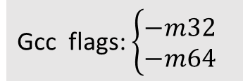
Machine Words
Any given computer has a “Word Size”
Based on computer architecture and compiler.
Nominal size of integer-valued data
and of addresses
Until recently, most machines used 32 bits (4 bytes) as word size
Limits addresses to 4GB (2³² bytes)
Increasingly, machines have 64-bit word size
Potentially, could have 18 EB (exabytes) of addressable memory
That’s 18.4 X 10¹⁸
Machines still support multiple data formats
Fractions or multiples of word size
Always integral number of bytes
Gcc flags: $\left\{\begin{aligned}−m32 \\ −m64\end{aligned}\right.$

Slide 62
Word-Oriented Memory Organization
32-bit
Words
64-bit
Words
Bytes
Addr.
Addresses Specify Byte Locations
Address of first byte in word
Addresses of successive words differ by 4 (32-bit) or 8 (64-bit)
0000
Addr
=
??
0001
0000
0002
Addr
=
??
0003
0000
0004
Addr
=
??
0005
0004
0006
0007
0008
Addr
=
??
0009
0008
000A
Addr
=
??
000B
0008
000C
Addr
=
??
000D
000C
000E
000F

Slide 63
Example Data Representations
C Data Type | Typical 32-bit | Typical 64-bit | x86-64
char | 1 | 1 | 1
short | 2 | 2 | 2
int | 4 | 4 | 4
long | 4 | 8 | 8
float | 4 | 4 | 4
double | 8 | 8 | 8
long double | − | − | 10/16
pointer | 4 | 8 | 8

Slide 64
Byte Ordering
So, how are the bytes within a multi-byte word ordered in memory?
Conventions
Big Endian: Sun, Internet
Least significant byte has highest address
Little Endian: x86, ARM processors running Android, iOS, and Windows
Least significant byte has lowest address
Try this command in your terminal:
$ lscpu | grep Endian

Slide 65
Byte Ordering Example
Example
Variable x has 4-byte value of 0x01234567
Address given by &x is 0x100
Big Endian
0x100
0x101
0x102
0x103
01
01
23
23
45
45
67
67
Little Endian
0x100
0x101
0x102
0x103
67
67
45
45
23
23
01
01

Slide 66
Representing Integers
Decimal: 15213
Binary: 0011 1011 0110 1101
Hex: 3 B 6 D
int A = 15213;
long int C = 15213;
IA32, x86-64
Sun
IA32
x86-64
Sun
6D
00
3B
00
6D
6D
00
00
3B
3B
3B
00
00
6D
00
00
3B
00
00
6D
00
int B = -15213;
00
IA32, x86-64
Sun
00
00
93
FF
C4
FF
FF
C4
FF
93
Two’s complement representation

Slide 67
Examining Data Representations
Code to Print Byte Representation of Data
Casting pointer to unsigned char * allows treatment as a byte array
typedef unsigned char *pointer;
void show_bytes(pointer start, size_t len){
size_t i;
for (i = 0; i < len; i++)
printf(”%p\t0x%.2x\n",start+i, start[i]);
printf("\n");
}
Printf directives:
%p: Print pointer
%x: Print Hexadecimal

Slide 68
show_bytes Execution Example
int a = 15213;
printf("int a = 15213;\n");
show_bytes((pointer) &a, sizeof(int));
Result (Linux x86-64):
int a = 15213;
0x7fffb7f71dbc 6d
0x7fffb7f71dbd 3b
0x7fffb7f71dbe 00
0x7fffb7f71dbf 00

Slide 69
Representing Pointers
Sun
IA32
x86-64
EF
FF
FB
2C
AC
28
F5
FF
3C
1B
FE
82
FD
7F
00
00
int B = -15213;
int *P = &B;
Different compilers & machines assign different locations to objects
Even get different results each time run program

Slide 70
Representing Strings
char S[6] = "18213";
Strings in C
Represented by array of characters
Each character encoded in ASCII format
Standard 7-bit encoding of character set
Character “0” has code 0x30
Digit i has code 0x30+i
String should be null-terminated
Final character = 0
Compatibility
Byte ordering not an issue
IA32
Sun
31
38
32
31
33
00
31
38
32
31
33
00

Slide 71
Integer C Puzzles
Check if the statements are always true?
Initialization
x < 0 => ((x*2) < 0)
ux >= 0
x & 7 == 7 => (x<<30) < 0
ux > -1
x > y => -x < -y
x * x >= 0
x > 0 && y > 0 => x + y > 0
x >= 0 => -x <= 0
x <= 0 => -x >= 0
(x|-x)>>31 == -1
ux >> 3 == ux/8
x >> 3 == x/8
x & (x-1) != 0
int x = foo();
int y = bar();
unsigned ux = x;
unsigned uy = y;

